Slide 1
TCA CYCLE
• Most of cells energy comes from oxidation of A.CoA in mitochondria
• Glycolysis oxidizes sugar to pyruvate which is converted to A.CoA in mitochondria
• Proteins and fatty acid are also broken down to yield A.CoA
• Acetyl units oxidized to CO2 in mitochondrial matrix by TCA cycle
• Energy released during oxidation captured by NAD+ and FAD
> Carried to ETC for synthesis of ATP (oxidative phosphorylation

Slide 2
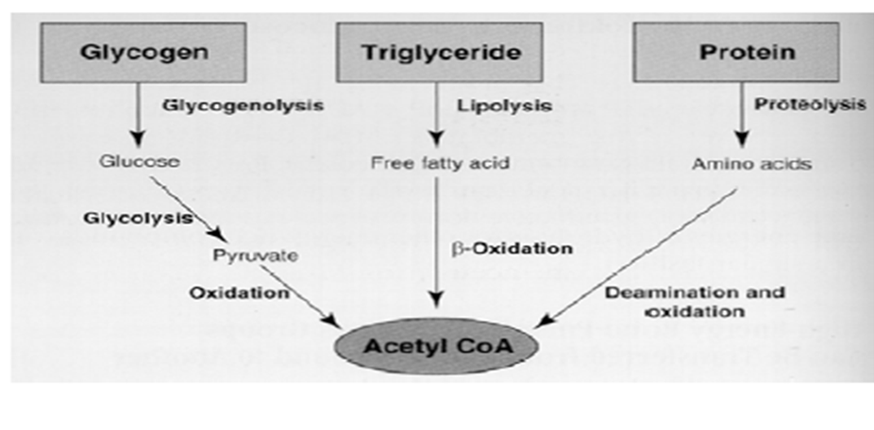

Slide 3
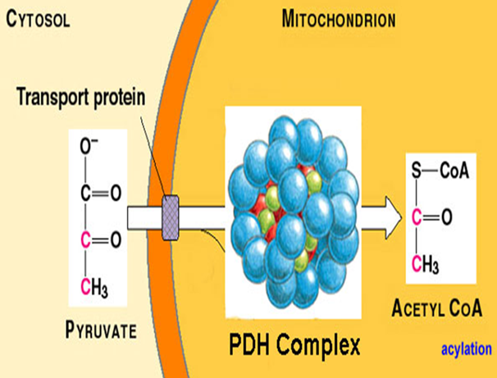
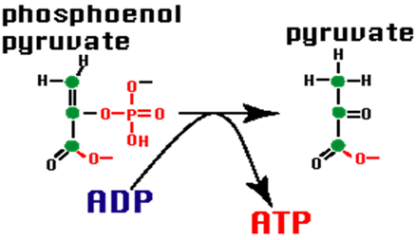

Slide 4
